Slide 1
EduQuiz Arena

Slide 2
Problem Statement
A multiplayer quiz platform where students can complete in real time quizzes on different subject.

Slide 3
Empathy
This platform understands that students want to feel connected and supported while learning, even online.
It knows that staying focused and motivated in virtual classes can be hard, so it creates a fun and friendly space where students can play quizzes together, learn from each other, and celebrate their achievements.
By encouraging teamwork and healthy competition, the platform helps every student feel included, confident, and excited to learn new things.

Slide 4
solution
The Real-Time Quiz Platform is a web-based system developed using HTML, CSS, JavaScript, PHP, and MySQL. Users can register, log in, and participate in quizzes created by the admin. Quizzes are displayed one question at a time with a timer, and answers are checked automatically.
Scores are stored in the database and a live leaderboard shows top performers. Admins can manage quizzes and questions easily, while users can view their results instantly. This system provides a secure, interactive, and competitive learning environment for all participants.

Slide 5
Technology Used
HTML – To create the basic structure of the web pages.
CSS – To make the pages look neat and attractive.
JavaScript – To add timer, question change, and live updates.
PHP – To connect the website with the database and check answers.
MySQL – To store user details, quiz questions, and scores.
XAMPP – To run PHP and MySQL on the local computer.
=

Slide 6
Features
Users can register, log in, and play quizzes in real time.
Admin can create and manage quiz questions easily.
The system shows timers, instant scores, and leaderboard.
Automatic score checking and result display after each quiz.
Has a simple, user-friendly interface for smooth use.

Slide 7
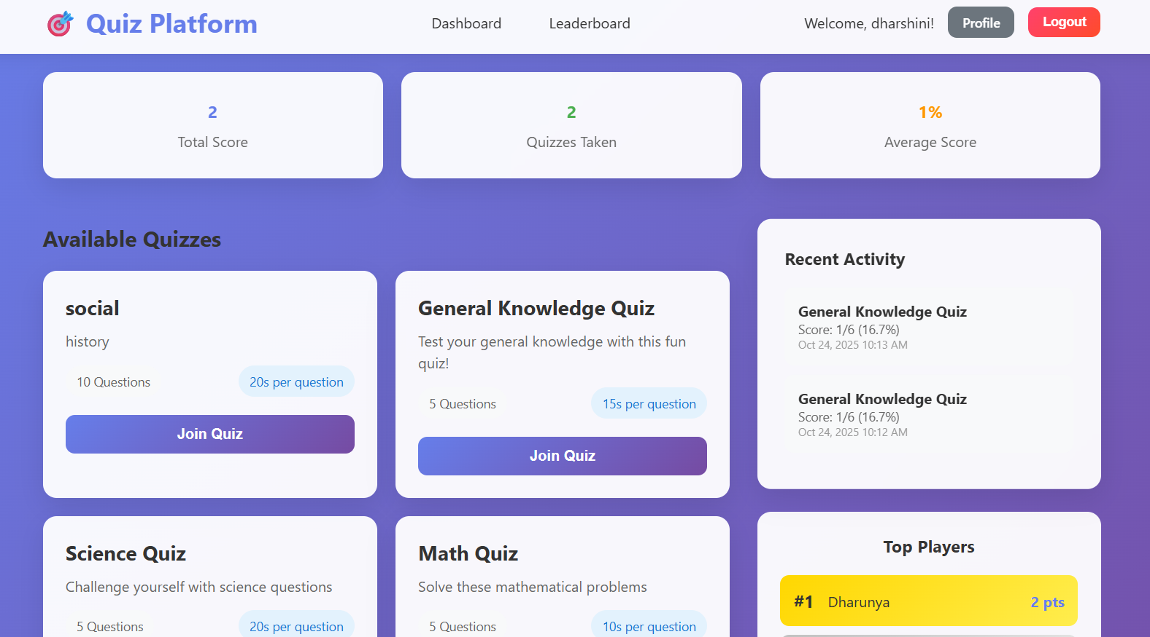
Sample Screenshot

Slide 8
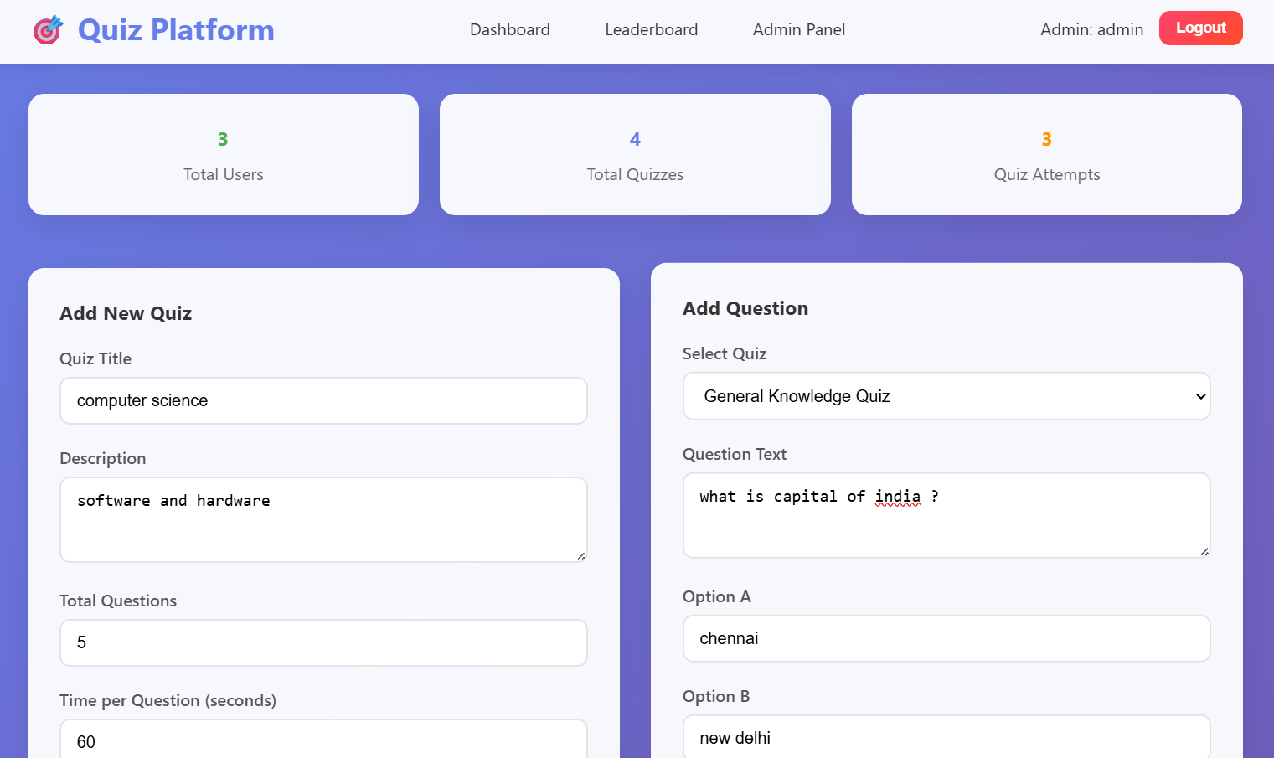
Sample Screenshot

Slide 9
Conclusion
The Real-Time Quiz Platform is a useful and interactive system that allows users to participate in quizzes simultaneously. It helps in improving knowledge, learning, and competition among participants. With features like timers, live results, automatic scoring, and leaderboard, it makes quizzes more engaging and fun. The platform is easy to use, secure, and provides a friendly environment for both users and admin to manage and play quizzes efficiently.

